Slide 1
Distracted driving

Slide 2
What is distracted driving?
Distracted driving is ANY activity that could divert your attention away from driving, such as:
Adjusting the radio, CD Player, MP3 player
Using Navigation System
Talking to Passengers
Eating and Drinking
What other distractions can you think of?

Slide 3
One of the most dangerous distractions?
Texting or talking on a hand-held cell phone involves THREE different types of distraction simultaneously:
Visual-Taking your eyes off of the road
Manual- Taking your hands off of the wheel
Cognitive-Taking your mind off of driving
http://www.itcanwait.com

Slide 4
Did you know?
Typing or reading a text message takes your eyes off the road for an average of 5 seconds. At 55 MPH, that is the equivalent of driving the length of a football field- BLINDFOLDED.
If you text while you’re behind the wheel, you’re 20 times more likely to be involved in a crash than a non-distracted driver.

Slide 6
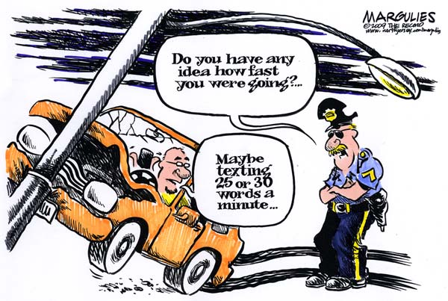

Slide 8
What is at stake?
Every year, about 421,000 people are injured in crashes that involved a driver who was distracted.
Last year, 3,154 people died in crashes caused by distracted driving.
Texting and driving is 6 times more likely to get you in an accident than drunk driving.
http://www.itcanwait.com

Slide 9
What is being done?
The U.S. Department of Transportation is leading the fight to end distracted driving through a combination of:
Tough Laws
Strong Enforcement
Increased public awareness
http://www.itcanwait.com

Slide 10
What can you do?
Make a pledge to protect lives by never texting or talking on the phone while driving.
Be a good passenger and SPEAK UP if the driver in your car is distracted.
Spread the word to your family and friends about the dangers of distracted driving.
https://youtu.be/kHfX5ia74qY

